Slide 1
CE/CZ2001
Mervyn, Kai Jun, Harsh, Zhe Ren
Group 6
Notes:
Hi, i am kai jun and this is harsh, today we will be presenting our groups algorithm and its analysis for the project. The language we used is Java. We only implemented one algorithm other than the brute force algorithm.

Slide 2
Breadth-first search
-Will iterate through all vertices that are connected to the source code.
-Once then it will trace back to the original root node and derive the shortest path
-relies on a queue rather than a stack

Slide 3
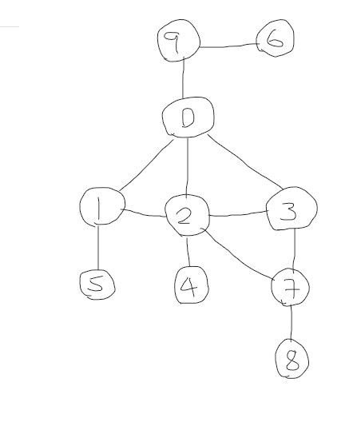
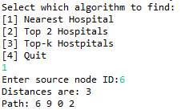
Code demonstration
Case 1 a) //this example case will be used for the following case examples, and assuming the hospitals are 2,3,7,8
Terminal result
Drawing of how the graph will turn out

Slide 4
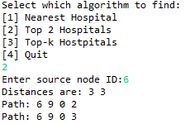
Code demonstration
Case 1 c)
As we can see from this, the 2 nearest is 2 and 3, and our output from the algorithm is 3 and 3 also the path printed is such.

Slide 5
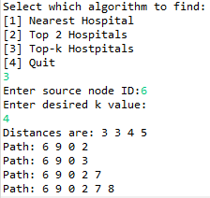
Code demonstration
Case 1 d)
As we can see from this, all the paths are created and the distance has been recorded down regardless of the k value

Slide 6
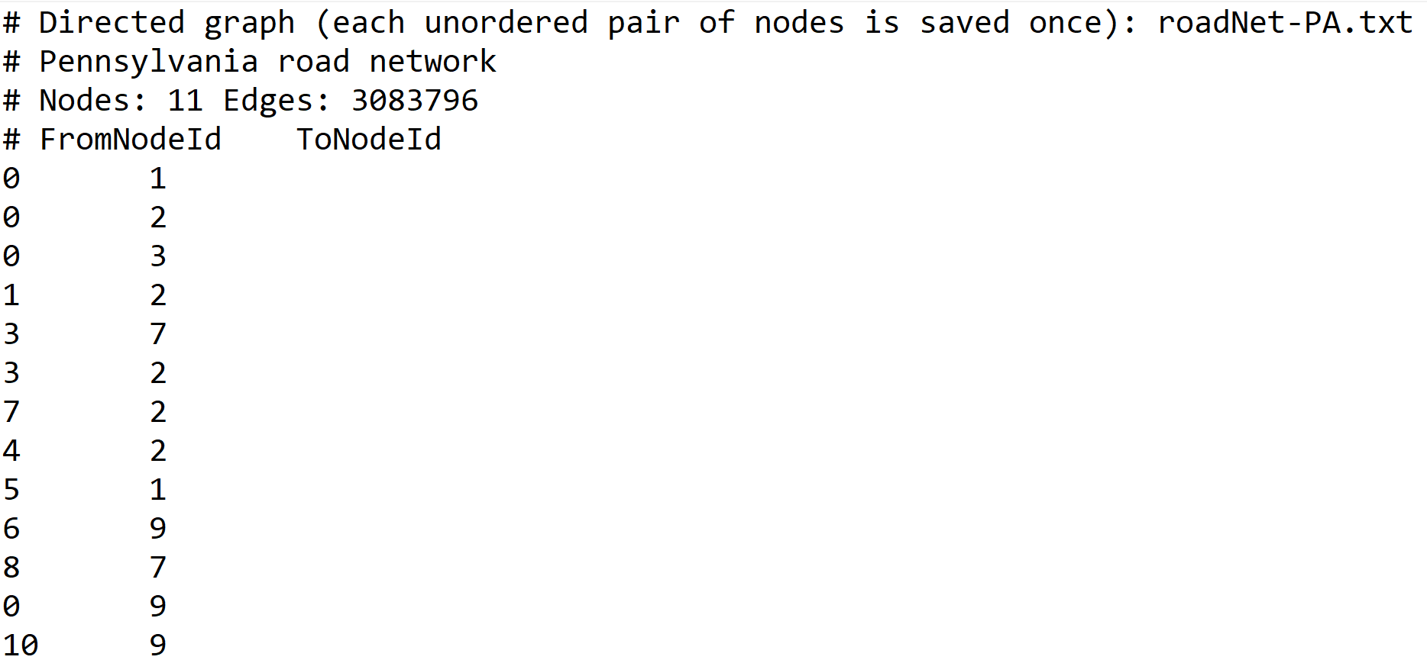
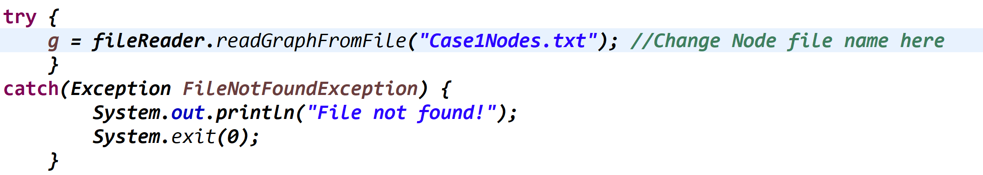
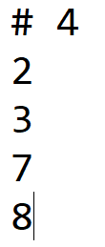
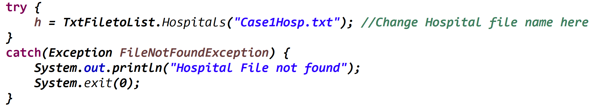
Code demonstration
Case 2+3 Small input graph)
These are the 2 input file codes and texts written within it, from this we fulfill the requirement of 2 file input

Slide 7
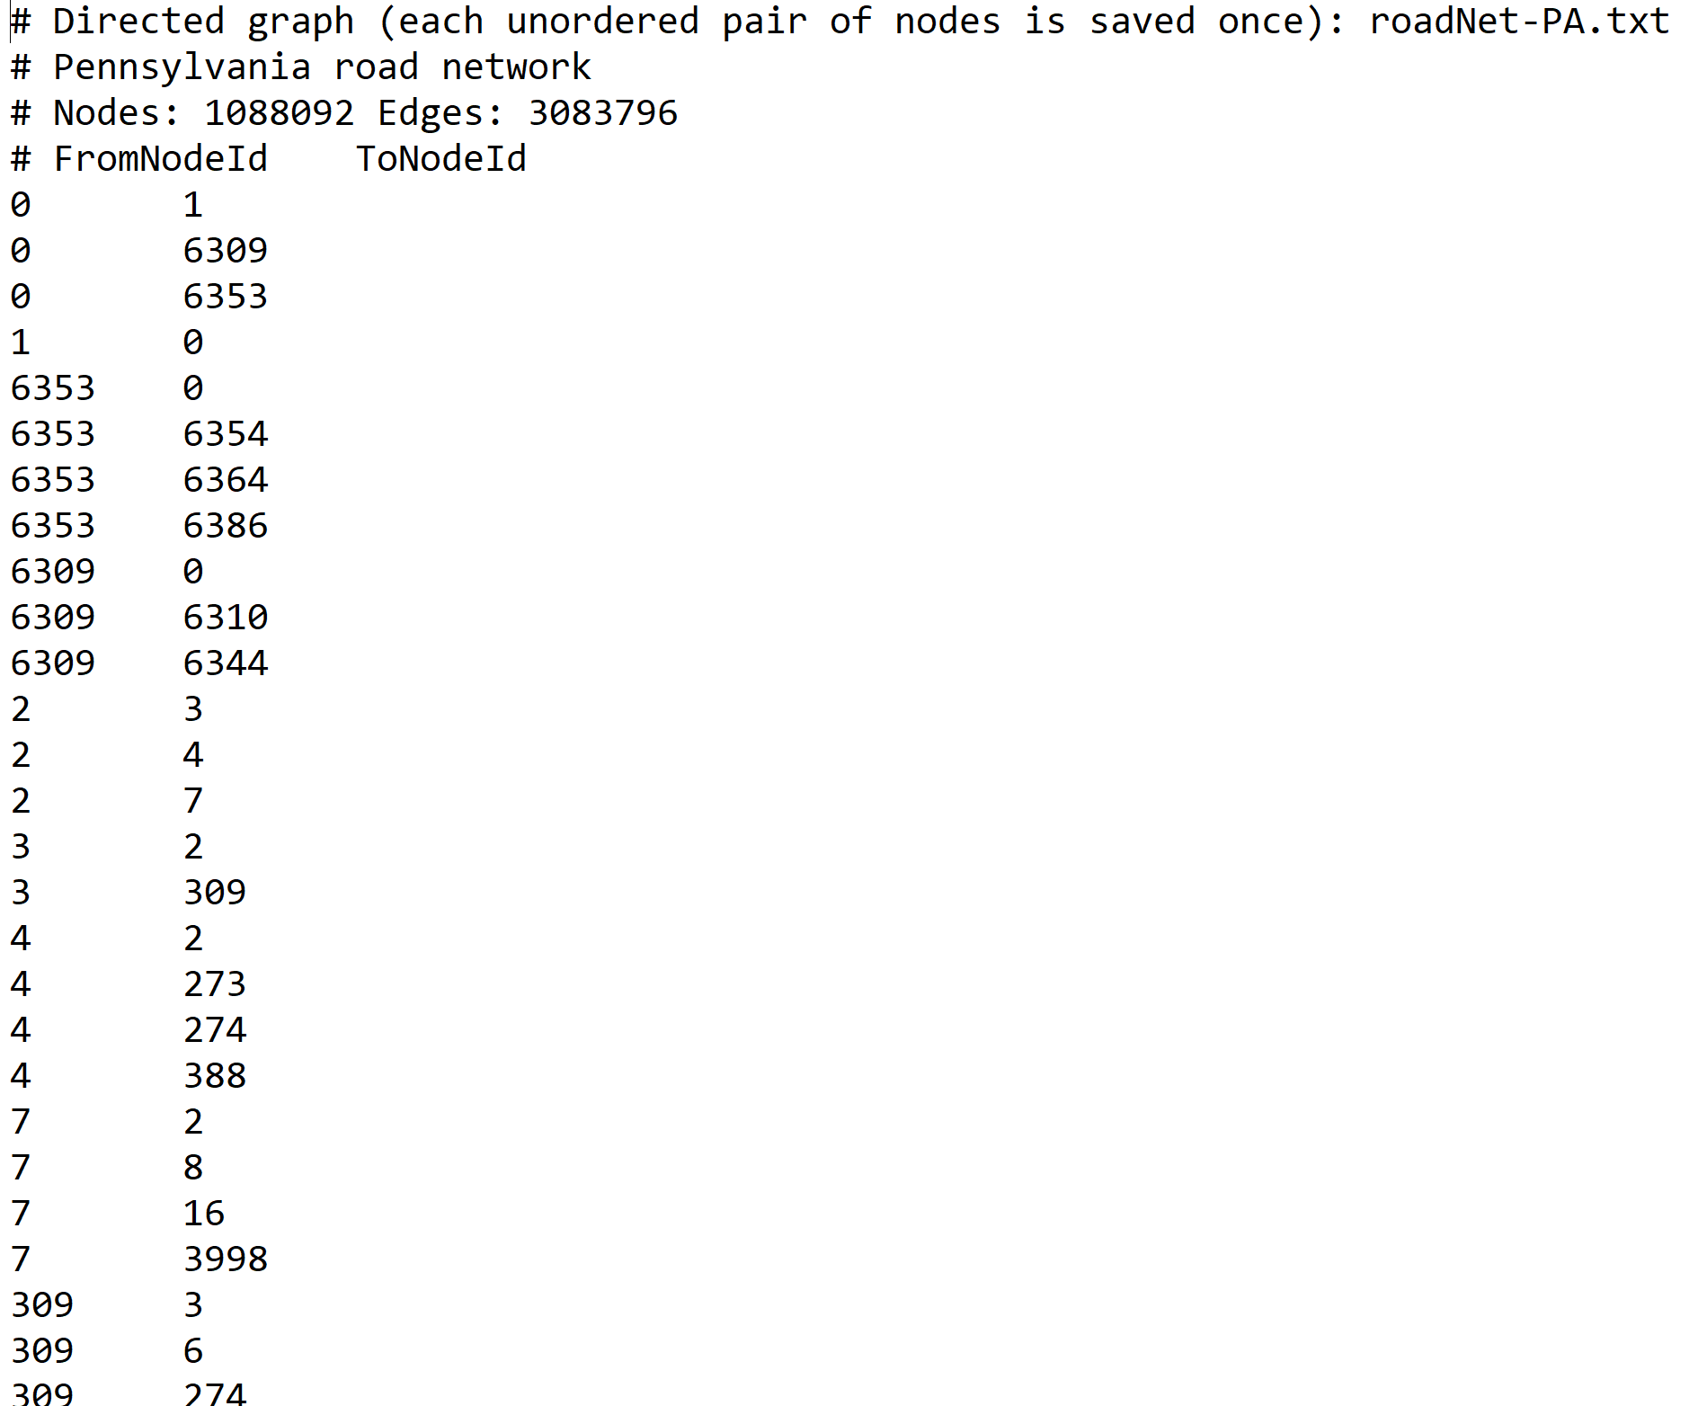
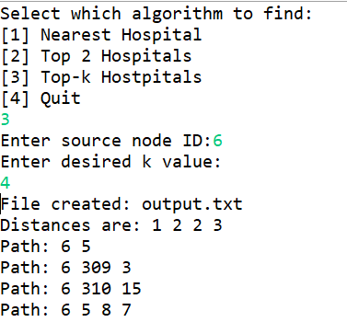
Experiment: Testing with real world network
Case 3 experiment:
Code output + real time network snippet, the actual naturally is very long

Slide 8
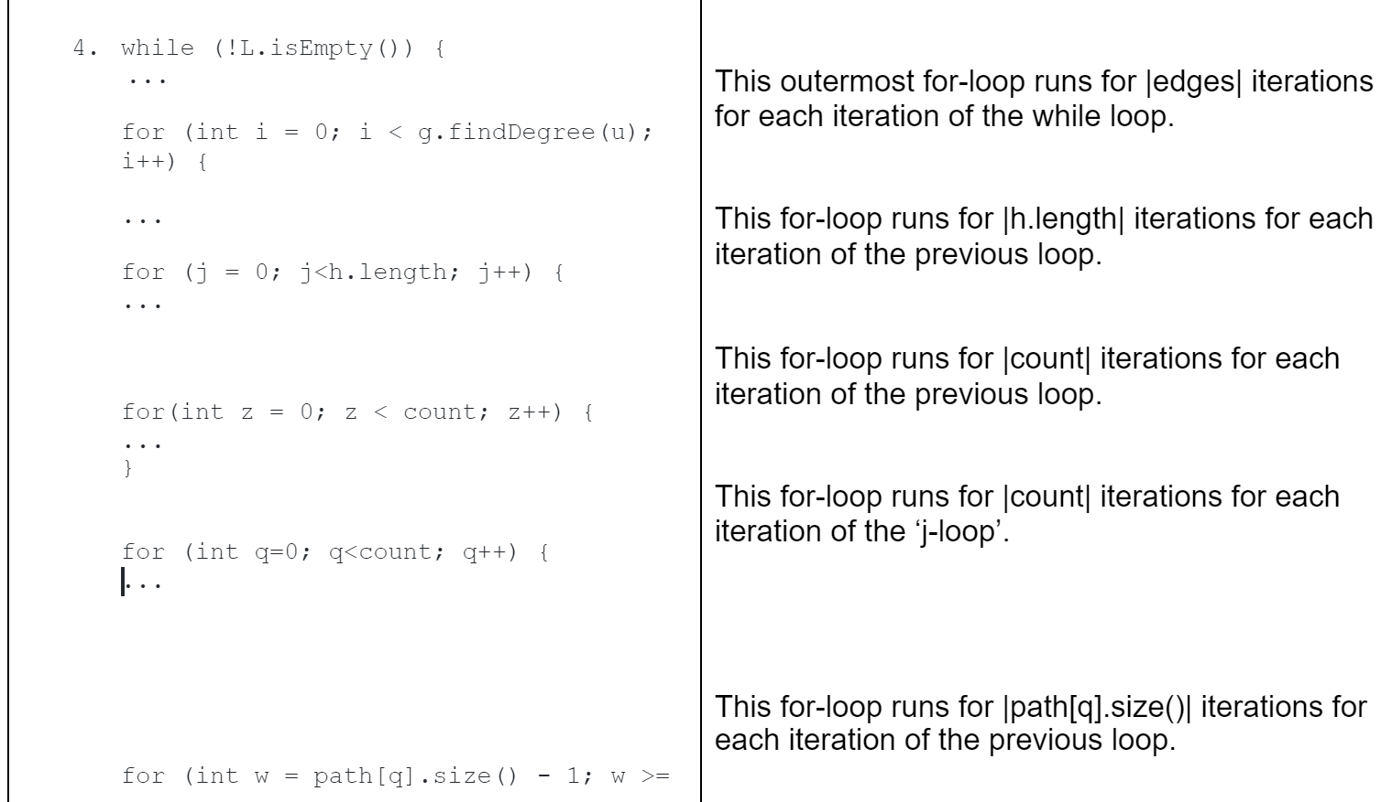
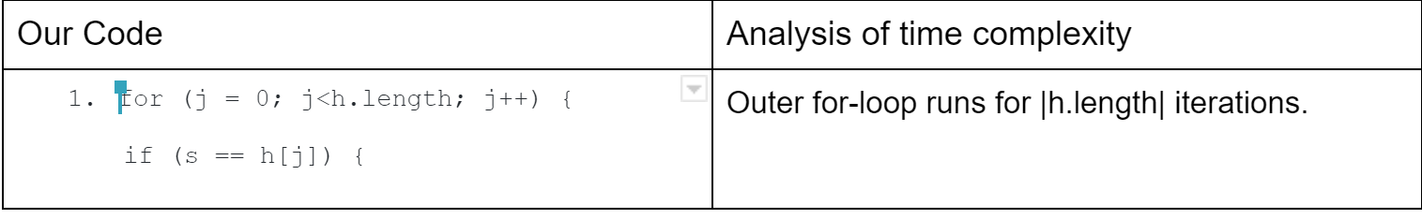
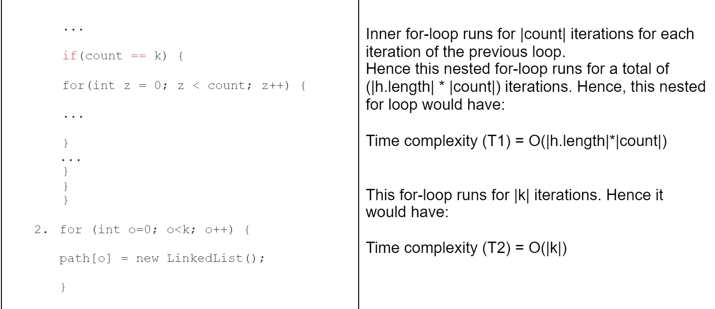
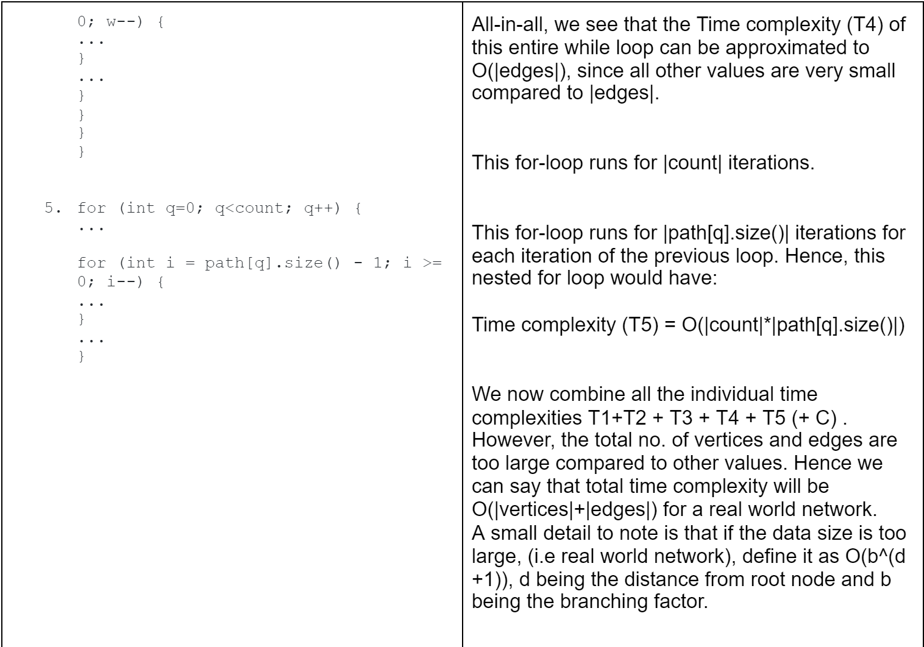
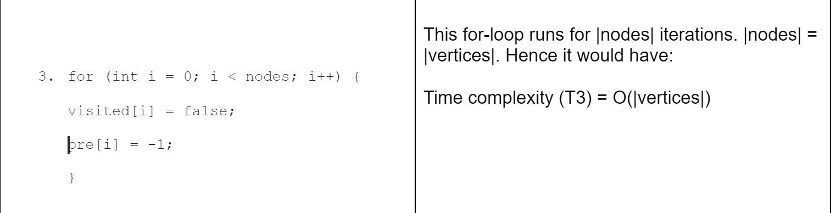
Time complexity

Slide 9
Empirical Study
Question statement: see the effects of h and k on the performance of various algorithms
Cases | h(hospitals) | K(top nearest number of hospital) | Empirical study BFS(total distance to h) | Various Algorithms(i.e BFS)(taken from online) | Theoretical Result
1 | 5 | 1 | 53 | 50 | 53
2 | 5 | 2 | 53, 54 | 50,51 | 53, 54
3 | 5 | 3 | 53, 54, 55 | 50,51,52 | 53, 54, 55
4 | 5 | 4 | 53, 54, 55, 55 | 50,51,52,53 | 53, 54, 55, 55
5 | 5 | 5 | 53, 54, 55, 55, 55 | 50,51,52,53,54 | 53, 54, 55, 55, 55

Slide 10
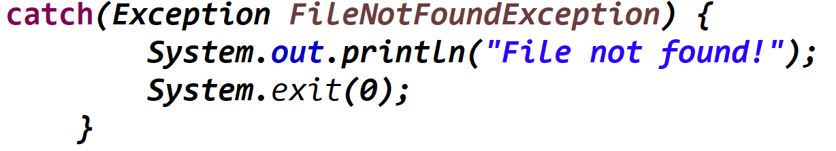
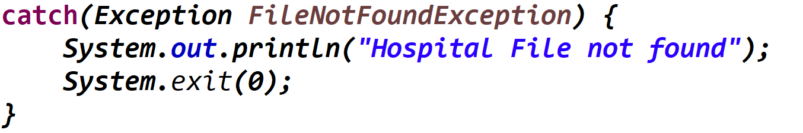
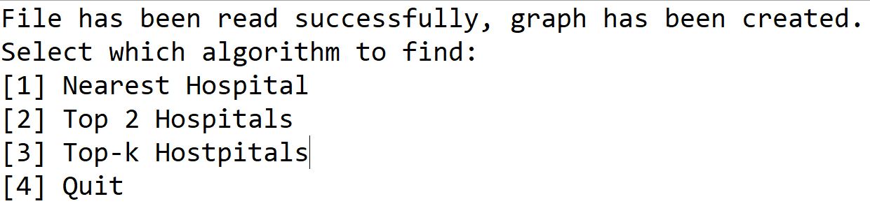
User friendly interface
Algorithm checks if you have the 2 input files loaded for the program before proceeding and if your do want to change files you only have to change the file paths in code to suit the file you want to read

